Slide 2
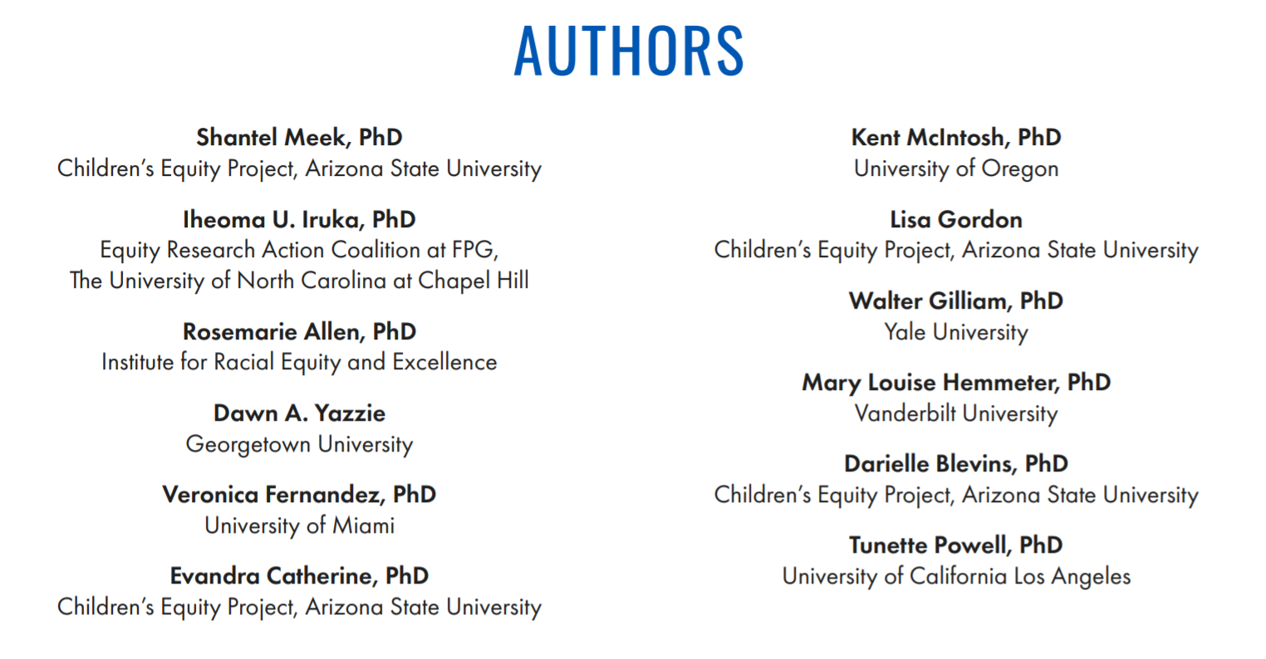

Slide 5
Congress Should:
Establish equitable funding formulas across learning systems that address historical marginalization- including on the basis of race, and disparities in access to resources, quality experiences, and outcomes.
Fully fund programs targeted at supporting historically marginalized communities.
Federal Agencies should:
Require all applicants for federal ECE funding to include data on resource disparities in their communities and describe how they will close such disparities.
Prioritize applicants for federal funding who propose to serve the most marginalized communities with less access to resources.
State and Tribes should:
Consider historical and current marginalization and disparities in access to resources, experiences, and outcomes when allocating ECE resources.

Slide 6
Congress should:
Fund a targeted, universal approach to ECE.
Incentivize holistic, strengths-based, and authentic integration in Head Start reauthorization.
Authorize and increase funding for the EHS-CCP and expand the model to include preschoolers.
Federal Agencies should:
Prioritize applicants who have a plan for socioeconomic and racial integration.
Issue guidance and TA on funding models that combine federal, state, tribal, and local funds for maximally integrated, inclusive, and supportive settings
States and Tribes should:
Develop plans to increase holistic, strengths-based, and authentic integration guided by community needs assessments.

Slide 7
Congress should:
Request annual Government Accountability Office (GAO) reports on equitable access to quality programming, quality experiences, and disparities in outcomes across ECE programs.
Federal Agencies, States, and Tribes should:
Ensure all federal ECE monitoring and accountability systems explicitly include equity indicators (See Box 1 for examples).

Slide 8
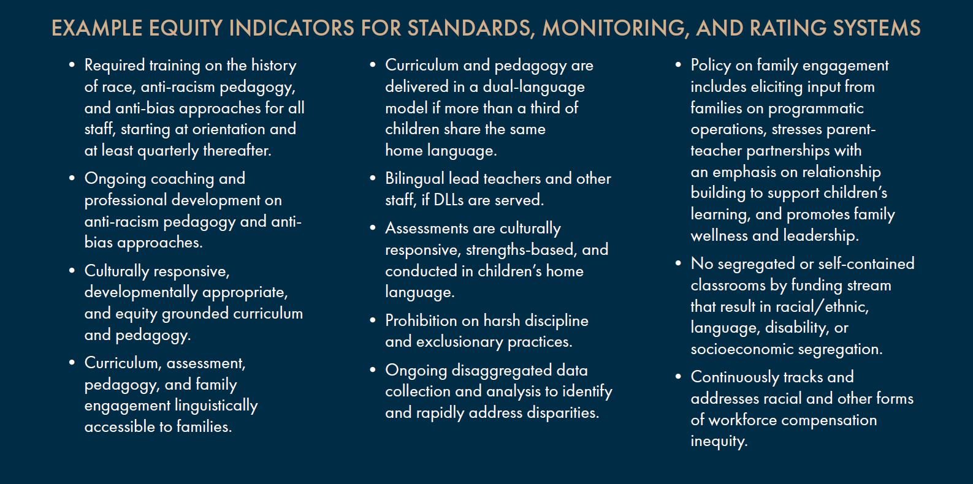

Slide 9
Congress should:
Increase funding for Child Care and Development Block Grant and Head Start, including tribal set-asides, and direct states/tribes to use part of the funding to increase workforce compensation.
Fund a new grant program that provides pathways for paraprofessionals and others in non-lead teacher roles, especially bilingual staff and staff of color, to attain the credentials, including higher education credentials, to become lead teachers.
Federal Agencies should:
Require pay parity, at a minimum, with K-12 teachers, across ECE programs that receive federal funds, regardless of age group taught.
Require states to track, report, and develop plans to address racial and other disparities in compensation and access to other supports
States and Tribes should:
Increase the value of child care subsidies
Track and develop plans to address racial disparities in compensation.

Slide 10
Federal Agencies should:
Fund dedicated and targeted equity TA across the early learning system and the early grades.
Use executive actions to require workforce racial equity training and coaching for ECE providers.
Fund research on effective racial equity training models and approaches in ECE systems to work toward attaining quality control.
State and Tribes should:
Ensure racial equity training content or coursework is required as part of professional credentialing and licensing systems.
Expand the racial literacy of all coaches in the professional development system.

Slide 11
States and Tribes should:
Ensure their QRIS and similar quality initiatives include equity indicators at every level and provide targeted funding to support programs in meeting such indicators, especially programs serving historically marginalized communities and programs that have historically had less access to systemic resources
Congress should:
Ensure that any articulation of quality standards in legislation explicitly integrates equity as an indicator of quality
Federal Agencies should:
Ensure that any federal funding for QRIS requires states to articulate how equity is integrated in indicators across all levels of their systems

Slide 12
Federal Agencies should:
Fund research that identifies the most effective, culturally and linguistically responsive, and scalable pedagogical approaches and curricula.
Develop and pilot a new measurement tool or set of tools that assess equitable learning opportunities — including pedagogy and curriculum — within ECE programs.
States and Tribes should:
Provide targeted funding and technical assistance to expand access to these approaches in Pre-K and child care, prioritizing historically marginalized communities.

Slide 13
States and Tribes should:
Ensure that equity measurement at the program or classroom level is explicitly incorporated into any state or tribe funding or monitoring related to global classroom quality measurement via QRIS systems or otherwise.
Congress should:
In all upcoming ECE-related legislation, ensure that any requirements related to global classroom quality measurement include explicit measurement of equity indicators
Federal Agencies should:
Fund new research to identify, adapt, and develop feasible, valid, and reliable measurement tools that capture equity in global classroom quality measurement.

Slide 14
Congress should:
Pass discipline reform legislation and increase funding for culturally responsive and evidence-based social and emotional supports.
Federal Agencies should:
Require states/tribes to report harsh discipline disaggregated by race, gender, disability, and language in all ECE programs that receive public funding, including child care.
States and Tribes should:
Prohibit harsh discipline, including seclusion, corporal punishment, and exclusionary discipline in all ECE programs that receive public funding.
Collect disaggregated data on the use of harsh discipline and support local communities on using discipline data systems

Slide 15
Congress should:
Fully fund IDEA, including Parts B Section 619 and C.
Increase funding for Part D of IDEA to increase monitoring and accountability efforts- particularly those related to preschool placement and the provision of the least restrictive environment
Federal Agencies should:
Ensure that all IDEA data reported to the federal government – including outcome data — are disaggregated by race, disability category, gender, and home language.
States and Tribes should:
Identify segregated preschool special education programs operating in the state/tribe and invest in meaningful structural reforms to expand high-quality inclusion,

Slide 16
States and Tribes should:
Invest in coordinated ECE data systems and ensure that they are used to track access, experience, and outcome disparities, feed information back to ECE programs, and use information to target resources to remedy inequities in a timely manner.
Congress should:
Require that all data reported to the federal government are disaggregated, and across legislation, encourage the use of and funding for continuous equity quality improvement systems.
Federal should:
Require all child-serving programs that receive federal funding to collect and report disaggregated data on access, experiences, and outcomes, and report how they are using the data to close racial opportunity gaps and outcomes.

Slide 17
States and Tribes should:
Ensure all state/tribal needs assessments across ECE systems include data about the strengths, needs, and social capital of families, as well as inclusion of family participation, voice, and reciprocity.
Ensure meaningful family engagement indicators are included in state standards and quality rating systems across levels
Congress should:
Promote family governance and meaningful culturally-responsive family engagement across the ECE system.
Federal Agencies should:
Collect meaningful family engagement data from federal ECE grantees
Fund new research to develop and evaluate measurement tools that meaningfully capture the effectiveness of family engagement strategies that include family participation, voice, and reciprocity.

Slide 18
States and Tribes should:
Ensure family child care and other ECE home-based providers are included in needs assessments, workforce development, and technical assistance efforts, and receive equitable support to access and move up QRIS.
Use child care quality funding to develop and grow family child care networks
Prioritize building family child care supply and networks in child care deserts.
Congress should:
Ensure TA efforts explicitly include resources tailored to family child care and other home-based providers and leaders.
Strongly encourage the inclusion of family child care providers — particularly those operating in child care deserts and those serving historically marginalized communities — in EHS-CCPs.

Slide 19
Congress should:
Invest in building capacity to expand dual language immersion opportunities for the youngest learners through a new grant program, and ensure that DLLs have priority for new slots.
Invest in teacher preparation and alternative certification programs to increase the supply of qualified bilingual early educators.
Federal should:
Add data on access to dual language immersion or other bilingual learning models in the Civil Rights Data Collection at the U.S. Department of Education.
States and Tribes should:
Adopt Head Start DLL standards in state-funded Pre-K and incorporate standards into monitoring and accountability frameworks.
Invest in producing the workforce necessary to support DLLs

Slide 20
Breakout Session
In your small group, each person can pick 1 of the 14 priorities and discuss:
If and how you have witnessed or experienced that inequity in your work or in your life.
What you can do in your job or in your role to contribute to closing that inequity and/or disparity.
What resources or supports would be helpful to address the inequity.
Identify one person who would be willing to share with the larger group some of your discussion points.

Slide 21
Report Out and Q&A

Slide 22
Thank You!
Check out the full report here: https://childandfamilysuccess.asu.edu/cep/initiatives/start-with-equity-14-priorities-dismantle-systemic-racism-early-care-education
Stay Connected with us on Twitter!
@ChildrensEquity

