Slide 3
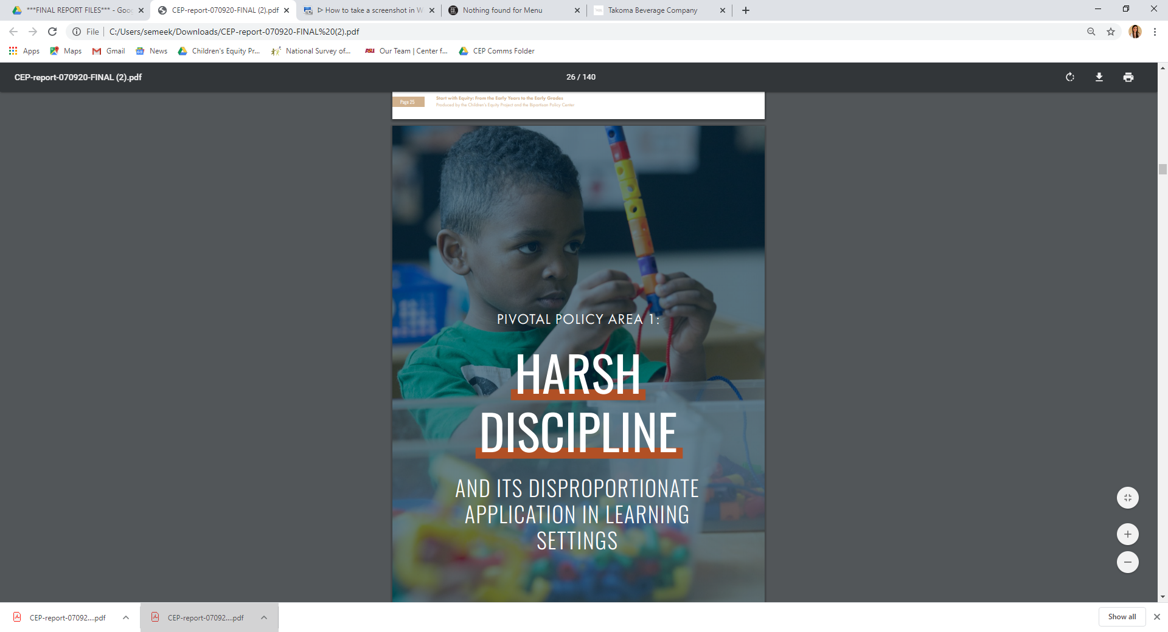
Corporal
Punishment
Expulsion
Suspension
Seclusion
Restraint

Slide 4
It starts early, it happens often, and its disproportionate.
Preliminary evidence that it occurs in infant/toddler child care.
No evidence that it works.
Abundant evidence that it has negative effects.
Rates and disparities vary between and within state lines
Driven by bias, inadequate training, misguided policies, poor working conditions, lack of supportive resources & school climate
Handful of interventions decrease exclusionary discipline, very few shown to reduce disparity
Largely unregulated federally
Large influx of state and community-level policy development since 2014
Quality of policies greatly vary

Slide 5
Suspension: An instance in which a child is temporarily removed from his/her regular school for at least half a day for disciplinary purposes.
Expulsion: Permanent termination of a preschool child's participation in a preschool program at a school or facility for disciplinary purposes.

Slide 6
Federal data find that nearly 5,000 children in public preschool were suspended in one school year alone.
Young children are more than 3x more likely to be expelled from public Pre-K than children in K-12
Child care rates may be even higher
National parent survey: 50,000 children under age five were suspended & 17,000 were expelled in one school year alone.

Slide 7
42% of infant/toddler child care programs expelled a child in the previous year
26% of child care programs had expelled at least one child in the past year
Dr. Gilliam’s 2005 study found that just over 10% of public Pre-K teachers had expelled a child, a rate already much higher than K-12 teachers.

Slide 9
AI/AN & Latinx children disproportionality varies. They are generally excluded at higher rates in later grades
Children within the AAPI group have significantly different rates. Pacific islander children had a risk ratio over 4x greater than Asian America children
K-12 children with disabilities are at least 2x more likely to be excluded
No disproportionality noted in younger children with disabilities**

Slide 10
State rates of suspension per 1,000 children,
Pre-K through elementary school

Slide 12
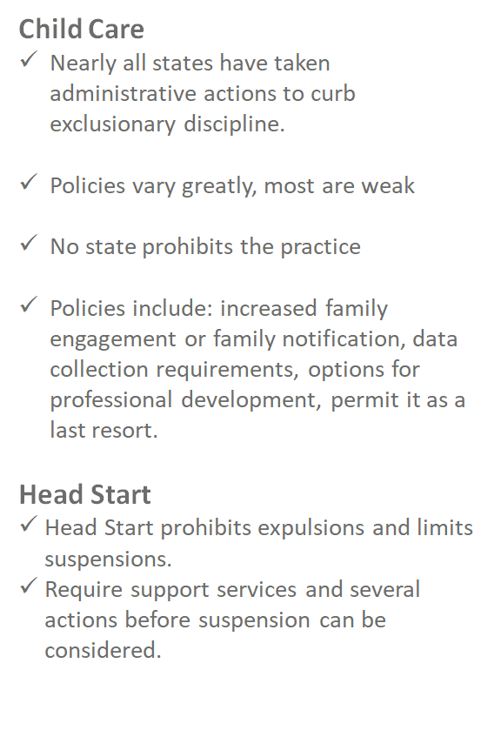

Slide 13
Pre-K- Early Grades
More than half of all states limit exclusionary discipline in Pre-K - early grades.
Extent of limitation varies

Slide 14
“Paddling, spanking, or other forms of physical punishment imposed on a child.”

Slide 15
It is legal in private school settings in every state in the country except New Jersey & Iowa.
45,000 public & private Pre-K–12 settings.

Slide 16
160,000 children Pre-K-12 subject to corporal punishment (CP) in a single school year. 1,500 3- and 4- year old's
Black children make up 16% of enrollment, but 33% of students who are corporally punished
40,000 Black children subject to CP in a single school year
Black boys 2x more likely to be corporally punished as White boys
Black girls 3x more likely to be corporally punished than White girls
In 4 states with the highest rates, MS, AL, AR & TX, children with disabilities make up 2/3 of cases
AI/AN children make up less than 1% of the preschool population but make up 9% of cases.

Slide 17
Notes:
160k – pk12
1,500 preschool

Slide 18
Restraint: A personal restriction that immobilizes or reduces the ability of a student to move his or her torso, arms, legs, or head freely. Mechanical restraint is the use of any device or equipment to restrict a student’s freedom of movement.
Seclusion: The involuntary confinement of a student alone in a room or area from which the student is physically prevented from leaving.

Slide 19
86,000 children were physically or restrained in a single school year
A 4-year-old girl, who was restrained to a wooden chair with leather straps to resemble an electric chair, was later diagnosed with post traumatic stress disorder. The catalyst for the restraint was “uncooperative behavior.”
19 states have no limits on restraint of children, and 12 states have no limits for restraint of CWD

Slide 20
Seclusion
36,000 children were secluded in a single school year.
A boy with a learning disability in elementary school was locked into a seclusion room 75x over a 6-month period for multiple hours at a time. The reasons cited for the seclusion included whistling, slouching, and hand waving.

Slide 21
Seclusion Policy
Notes:
Only two states ban seclusion outright, and five states ban it for children with disabilities. Nineteen states limit seclusion to instances involving a serious safety threat (for all children), and 24 states limit it for children with disabilities. Sixteen states allow for seclusion when there is no emergency or safety risk, either explicitly or via loopholes in policy.

Slide 22
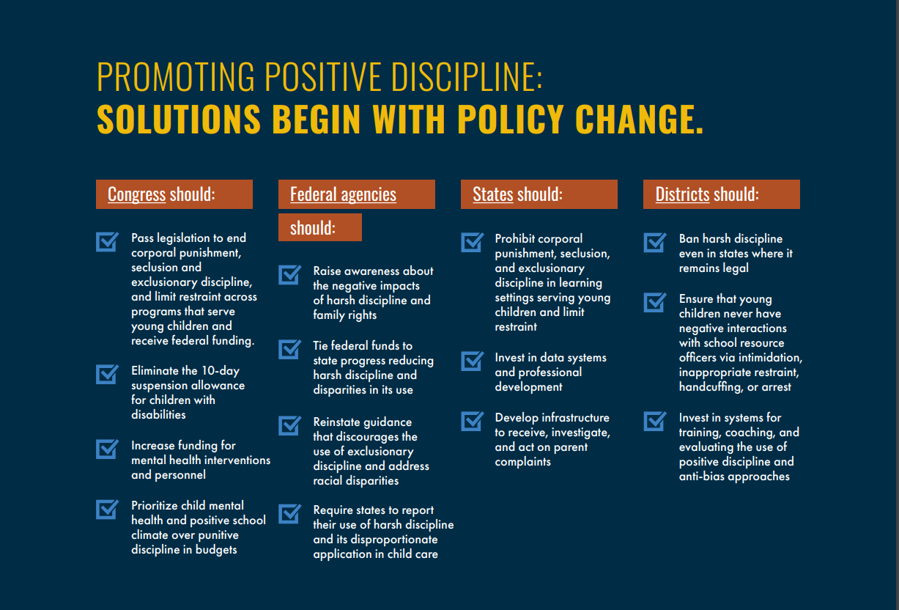

Slide 23
Join us for our Upcoming Webinars!
Inclusion
Tuesday, July 28th, from 3-4:30 p.m. ET
Dual Language Learning
Thursday, August 6th from 3-4:30 p.m. ET
Sign up and Download the Full Report Here:
https://childandfamilysuccess.asu.edu/cep/start-with-equity
Follow us on twitter:
@ChildrensEquity @BPC_Bipartisan
&
Help us share our new report using #Startwithequity

